Slide 1

Oriental Zodiac Patronus
ELLIE CHEN
Notes:
https://images.app.goo.gl/4LmLUhtL7GYdidrRA

Slide 2
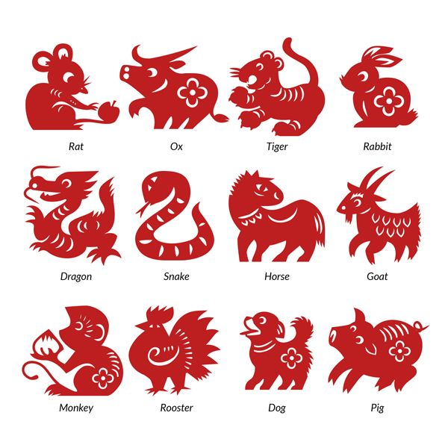
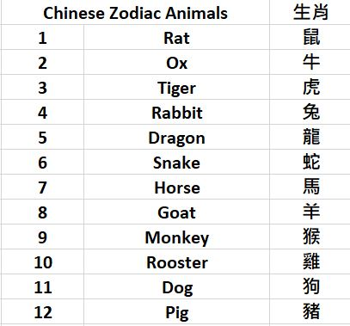
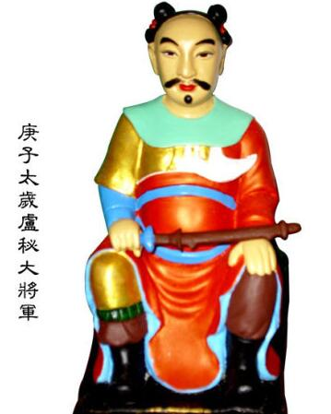
Chinese Zodiac Animals (ShengXiao)
‘Tai Sui’ (太歲 )in 2020

Slide 3
Features
Feature 1: Chinese Zodiac Animal Test
Feature 2: Animal Compatibility Test
Feature 3: Luck Prediction in 2020 - Tai Sui Test

Slide 4
Reflection
What I enjoy most about creating this app?
What I struggle with during the process?
What I would do different next time?

Slide 5

Questions?

